Slide 1
Lesson 2 – Working with Javascript Variables & the Document
STARTER
True or False
Javascript can create animations
Javascript is not case sensitive
Javascript can run in your browser
Javascript lines end in colons :
Javascript is used on almost every web site
TRUE
FALSE
TRUE
FALSE
TRUE
COOL JavaScript Examples
https://codepen.io/jackrugile/pen/acAgx?page=3
https://codepen.io/tholman/pen/jvIEz?page=1&
https://codepen.io/jackrugile/pen/Drykf?page=2
Notes:
https://codepen.io/tholman/pen/jvIEz?page=1&

Slide 2
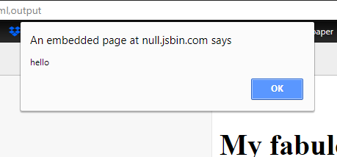
Using the alert()function
Revision!
screenshot your work!
This will create a pop up
Change
<button>Click Me!</button>
to
<button onclick="alert('hello')">Click Me!</button>
Now click the button and a pop up appears
Change the message to something else

Slide 3
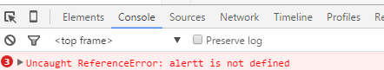
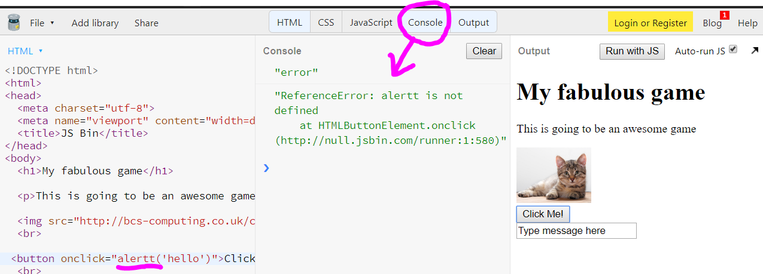
Debugging errors
Revision!
Javascript errors can be tricky to track down
Use F12 on a web page to show the Console
Or in JSBIN there is a console button
This tells me I’ve spelled “alert” wrong!

Slide 4
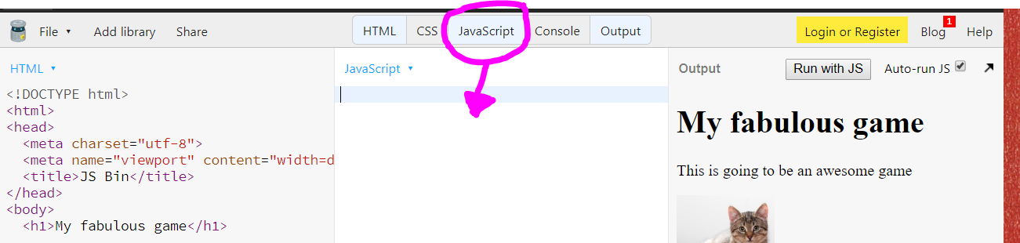
Creating a Javascript function
At the moment the Javascript is being written inline with the HTML
This will get confusing when we start to write longer programs
Creating a block of code called a function allows us to separate the Javascript out to make it easier to manage
In JSBin we need to show the Javascript tab:

Slide 5
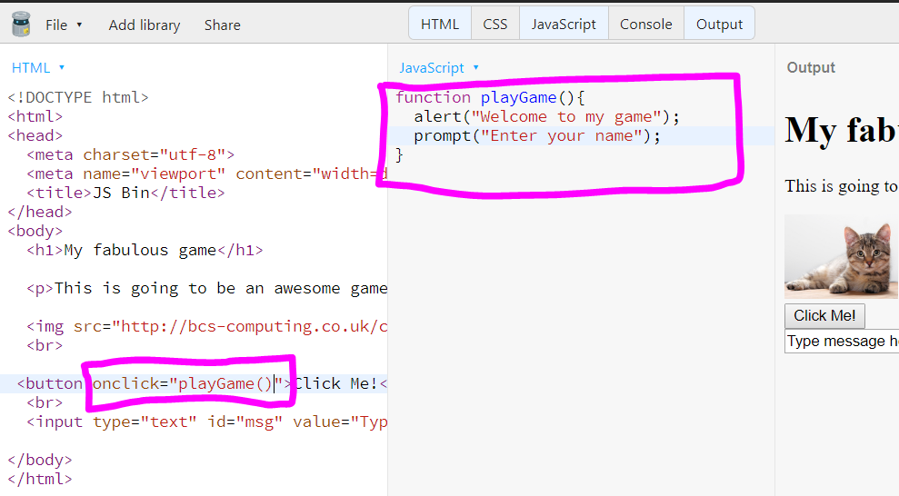
Creating and running a function
STEP 1: Define the function
STEP 2: Run the function
Notes:
Love Tester Demo:
http://jsbin.com/nihivaxuko/1/edit?html,css,output

Slide 6
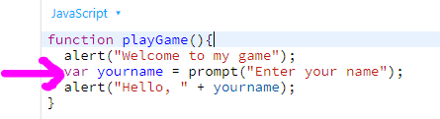
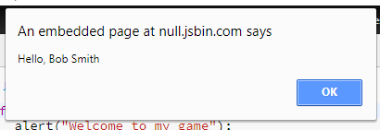
Using variables in JavaScript
Use the var keyword when you first set up a variable
You can "stick" variables and text together (concatenate) using a + sign
Variable names…
-Must be one word
-Can't start with a number
-no punctuation
FYI – new versions of Javascript also use "let" as well as "var"

Slide 7
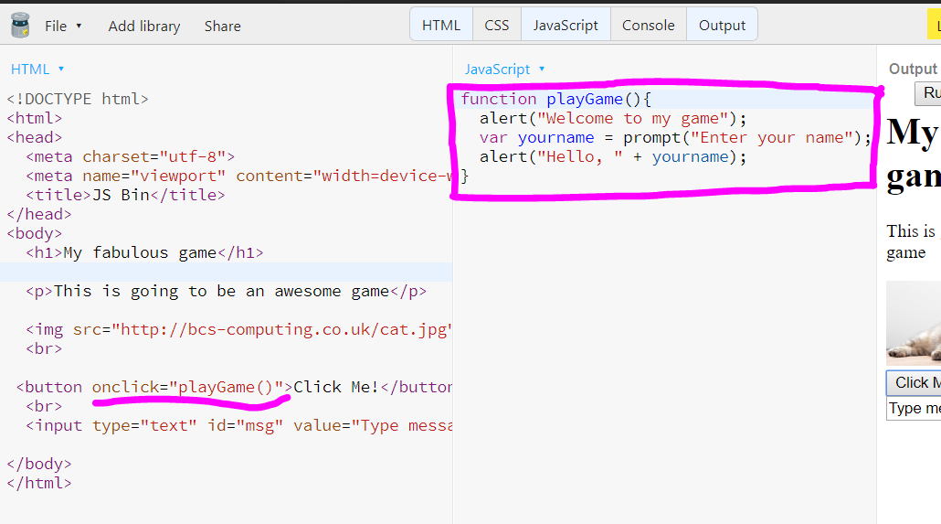
Task: Practice creating and running a function
Add a function with a couple of alerts and a prompt to ask the user a question
(This is practice – and doesn't have to be part of your final game)
STEP 1: Define the function
screenshot your work!
STEP 2: Run the function

Slide 8
Changing the document with Javascript
document.body.style.backgroundColor="red"
What do you think this line will do?
You can also use color hex codes such as
  #ff6600
  #00ff00
WatCH ThE CaSE of THIs LiNE of jAvAScript!!!
You can change lots of things on a web page – images, text, divs – more later…
amount of Red
amount of Green
amount of Blue
Notes:
http://jsbin.com/diceqoqife/2/edit?html,js,output

Slide 9
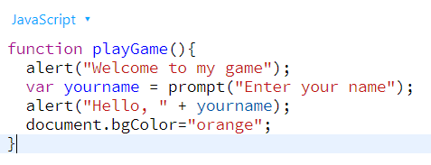
Task: Change the background colour
Add a line to change the background colour to your button.
Extension:
  Research "hex color codes" to find other colours you could use
  Add more buttons to change to different colour
  Add the line to change the colours at several points in your script and see what happens
screenshot your work!
document.body.style.backgroundColor="orange"
or use "#ff6600"

Slide 10
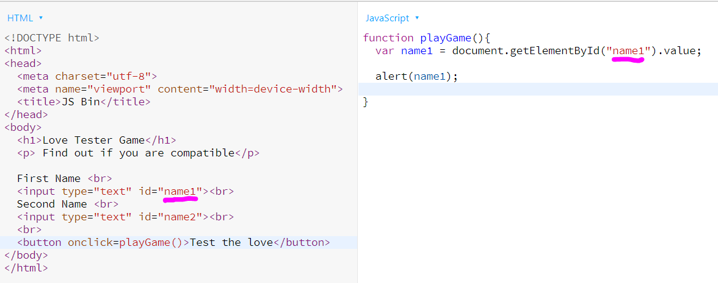
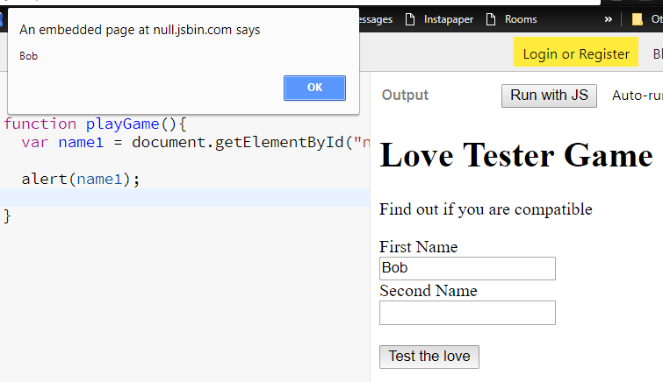
Getting data out of fields that the user has typed in
http://jsbin.com/raxogojesi/1/edit?html,js,output
document.getElementById("name1").value
"name1" is the id of the input tag
Be careful of the spelling of getElementById
store it in a variable and use it in your program
screenshot your work!
Notes:
Love tester :
http://jsbin.com/raxogojesi/1/edit?html,js,output

